Slide 1
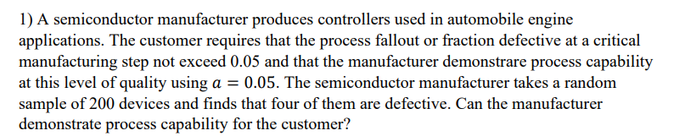
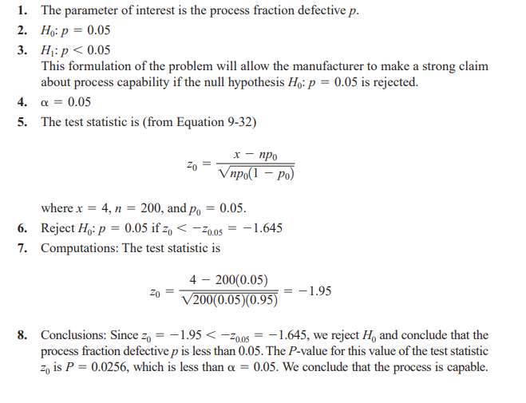

Slide 2
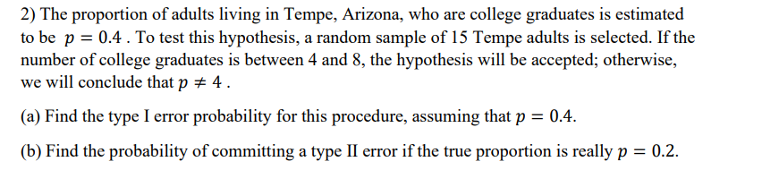
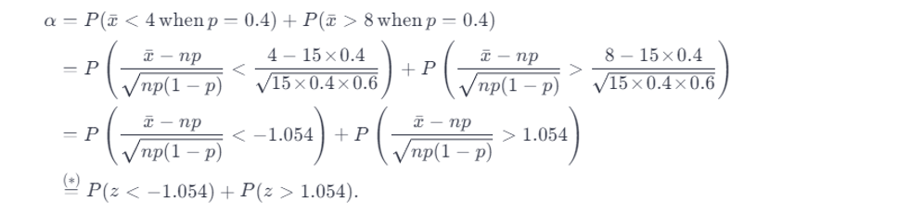
0.2937

Slide 3
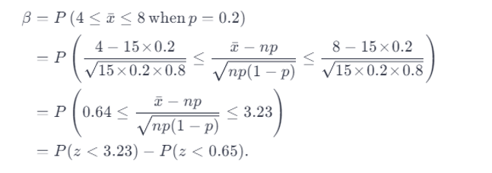
0.2572

Slide 4
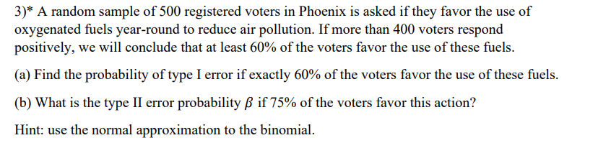
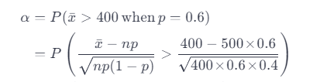
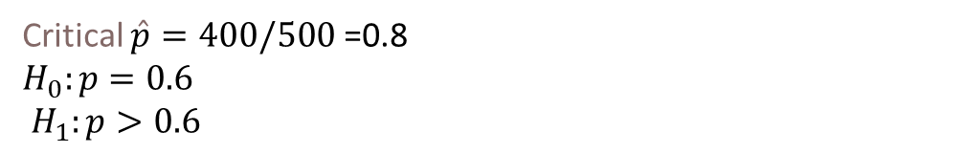
Critical $\hat{p}=400/500$ =0.8
$$H_{0}:p=0.6$$
$H_{1}:p>0.6$
=9.12
P= (Z>= 9.12) = 0

Slide 5

$Z_{0}= \frac{\hat{p}−ρ_{0}}{\sqrt{ρ_{0}(1 −ρ_{0})/n}}$ =
.8-.75/ $\sqrt{0,75(\frac{0.25}{500})}$
=2.581
P= (Z<=2.581) = 0.995

